Slide 1

Exploratory Data Analysis: Heart Disease Risk Factors
By Chelsa Mariam John
Reg No. 12214129

Slide 2
Introduction
EDA is an essential step in data analysis, enabling us to thoroughly explore the data, discover hidden patterns, identify anomalies, and test hypotheses. This presentation highlights an Exploratory Data Analysis (EDA) of a dataset centered on heart disease and its factors. The goal is to reveal patterns and relationships within the data to gain insights into the main factors linked to heart disease.

Slide 3

Title: Exploratory Data Analysis: Heart Disease Risk Factors
Cleaned Dataset: Heart Disease Indicators
Objective: To understand factors associated with heart disease risk

Slide 4
Data Overview
Total observations: 229781
Variables: HeartDiseaseorAttack, HighBP, HighChol, CholCheck, Smoker, Stroke, Diabetes, PhysActivity, Fruits, Veggies, HvyAlcoholConsump, AnyHealthcare, NoDocbcCost, GenHlth, DiffWalk, Sex, Education, Income
Variable types: Mix of continuous and categorical

Slide 5

UNIVARIATE ANALYSIS

Slide 6
→ Central Tendency: Measures like mean, median, and mode. →Dispersion: Measures like range, variance, and standard deviation. →Distribution: Shape of the data distribution, using histograms, box plots, and density plots. →Frequency: Frequency distribution for categorical data, often visualized with bar charts or pie charts.
Univariate analysis involves the examination of a single variable to understand its distribution and properties. It focuses on:

Slide 7
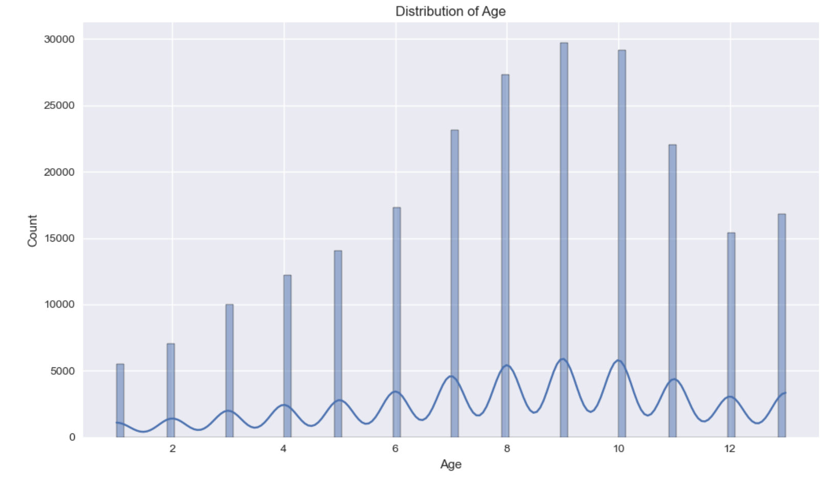
Age Distribution
Age categories range from 1 to 13
Mean age category: 8.09
Slight right skew in distribution

Slide 8
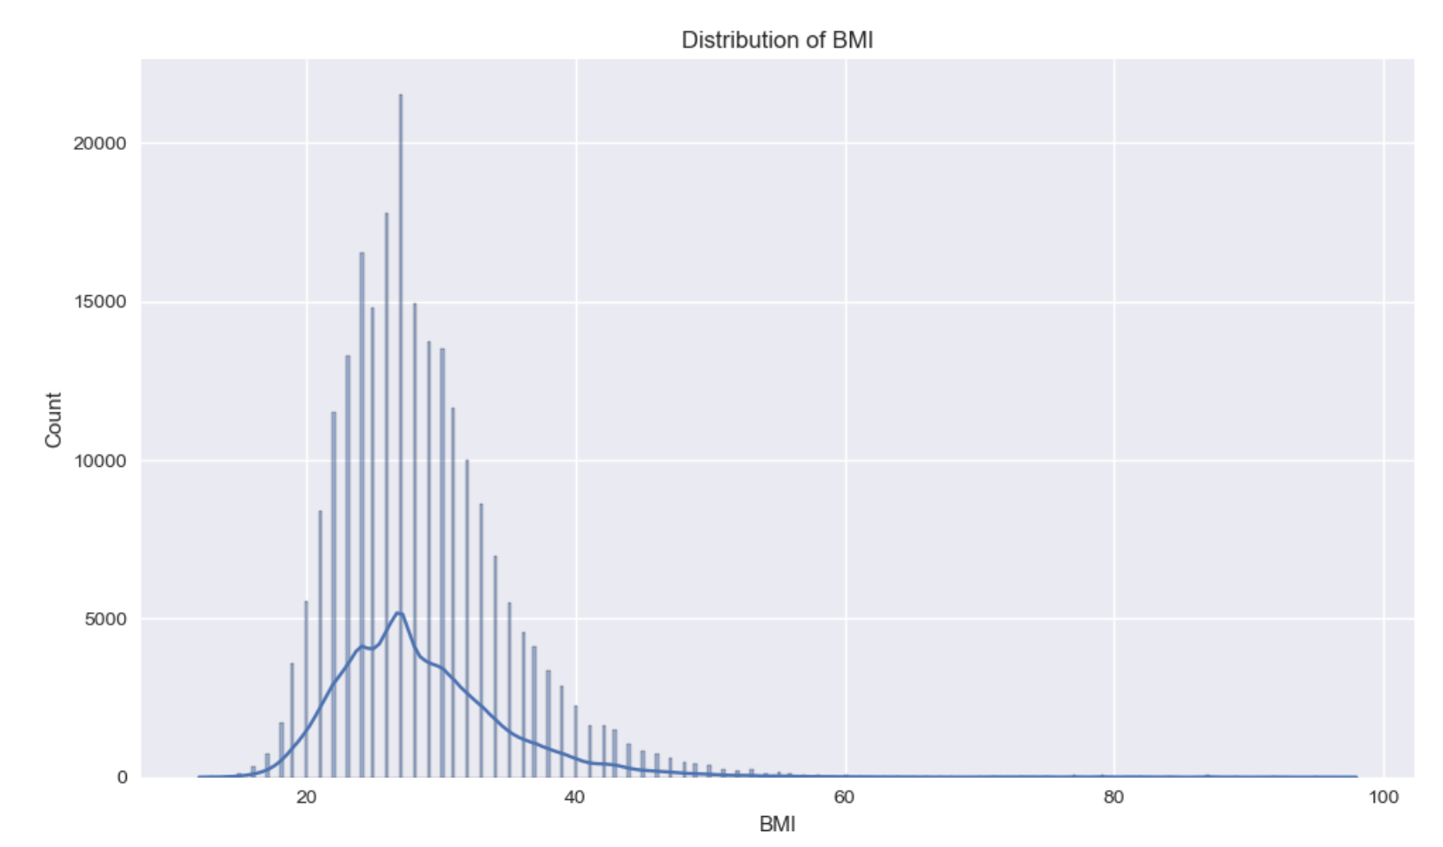
BMI Distribution
Mean BMI: 28.69 (overweight category)
Range: 12 to 98
Right-skewed distribution

Slide 9
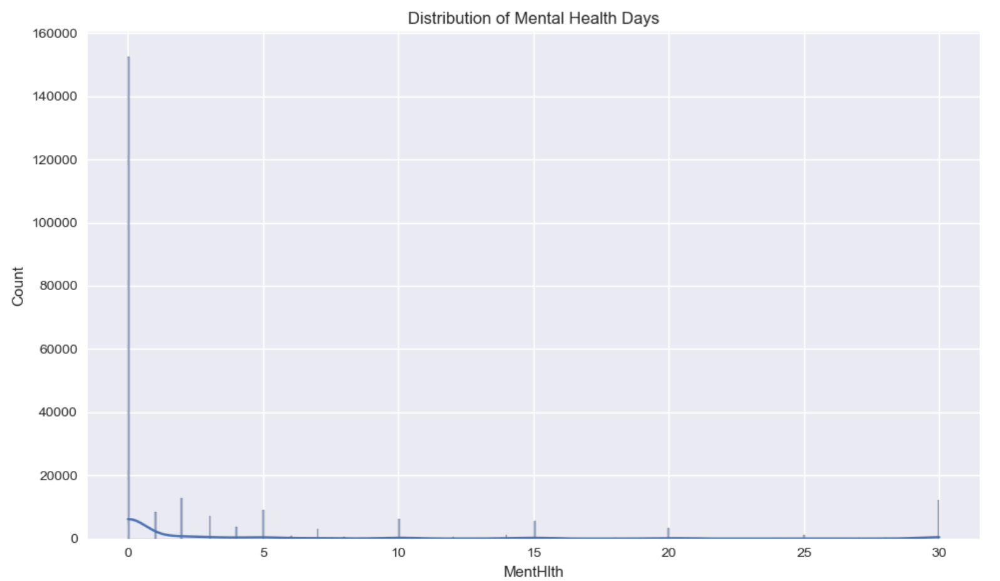
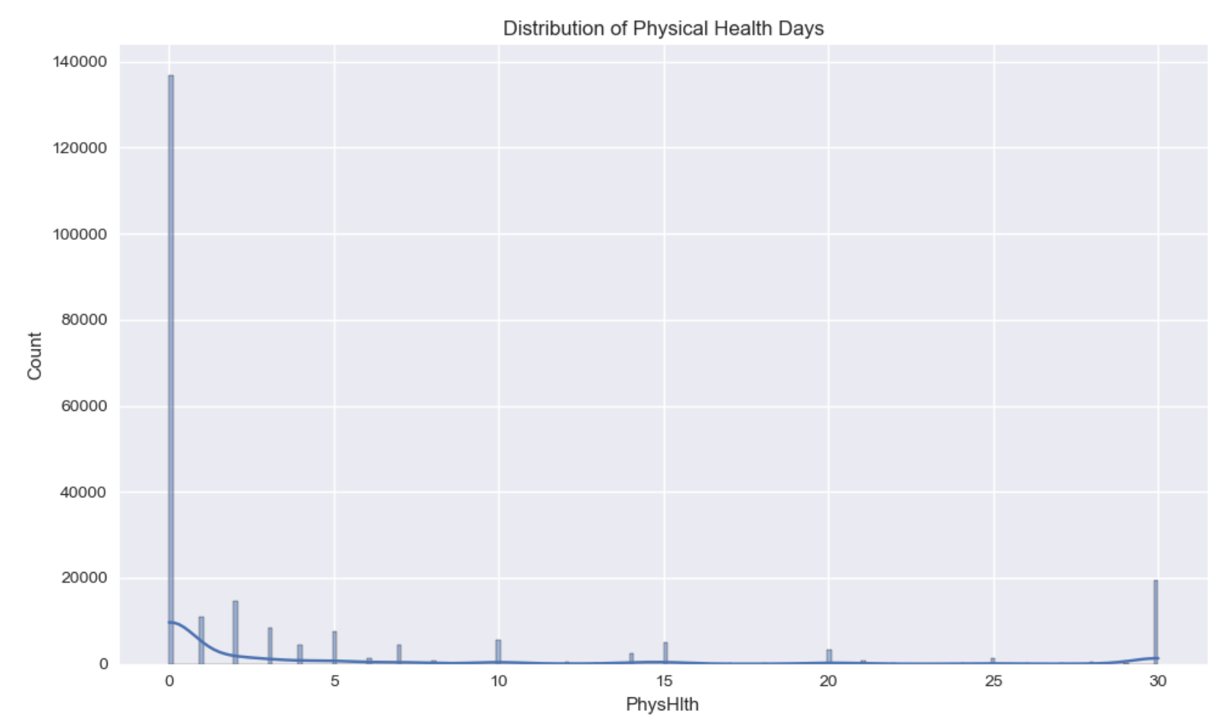
Mental and Physical Health Days
Both heavily right-skewed
Mental Health: Mean 3.51 days, median 0
Physical Health: Mean 4.68 days, median 0

Slide 10
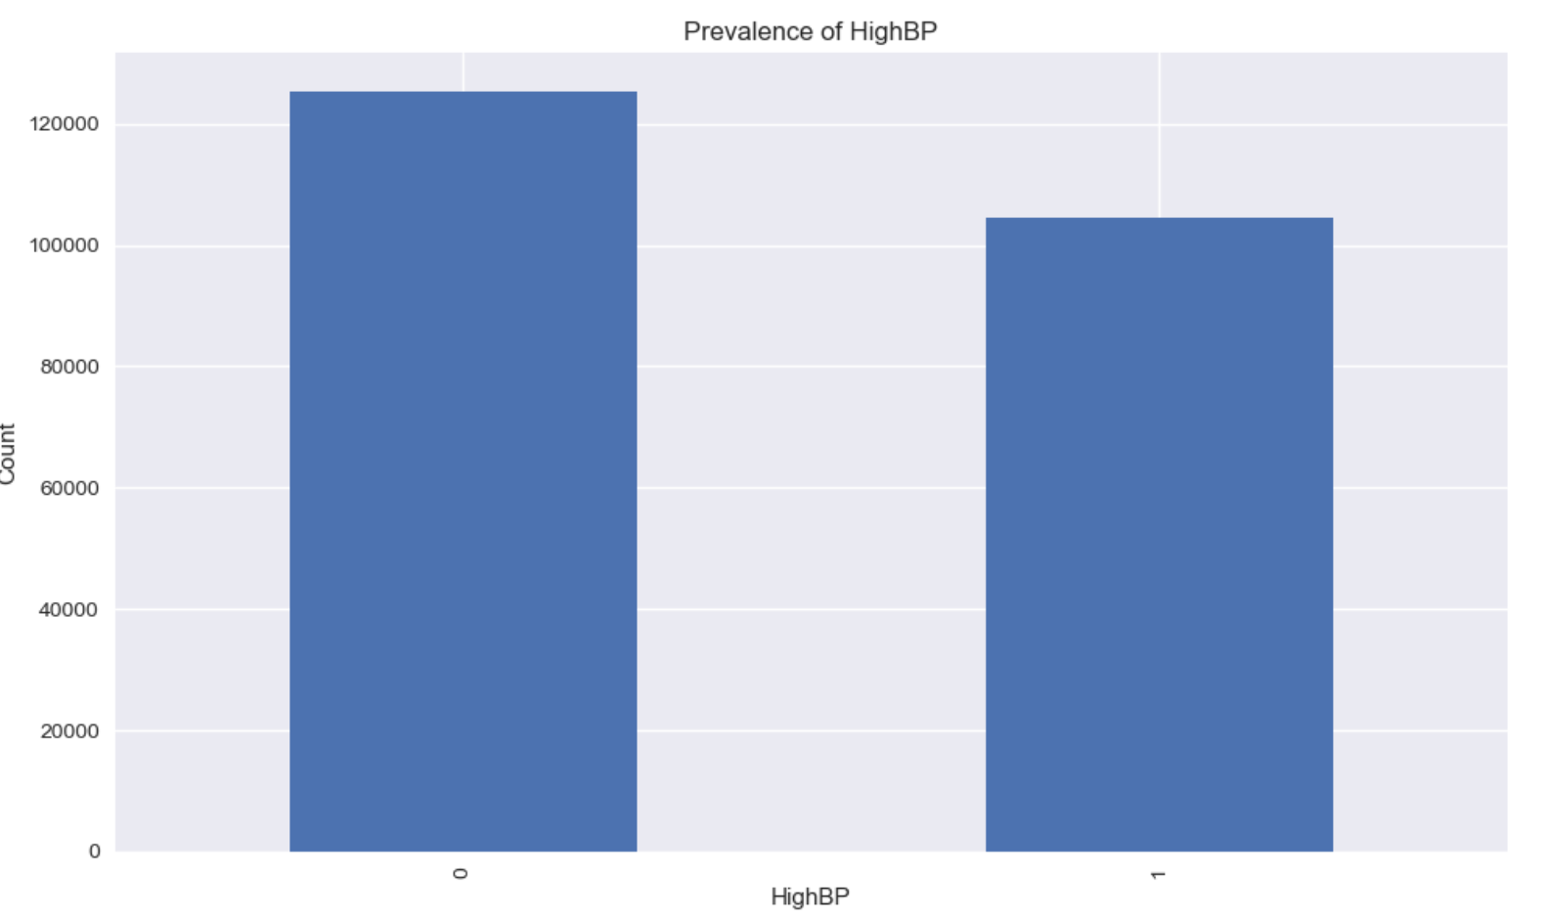
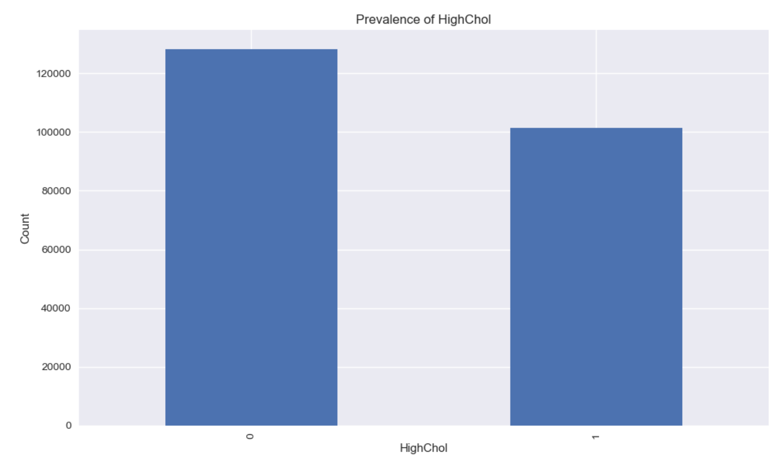
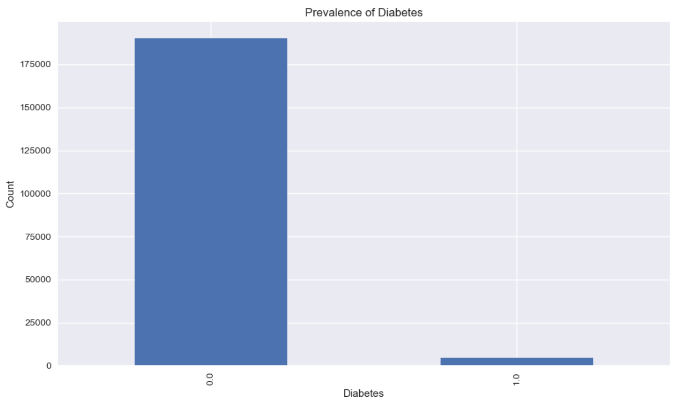
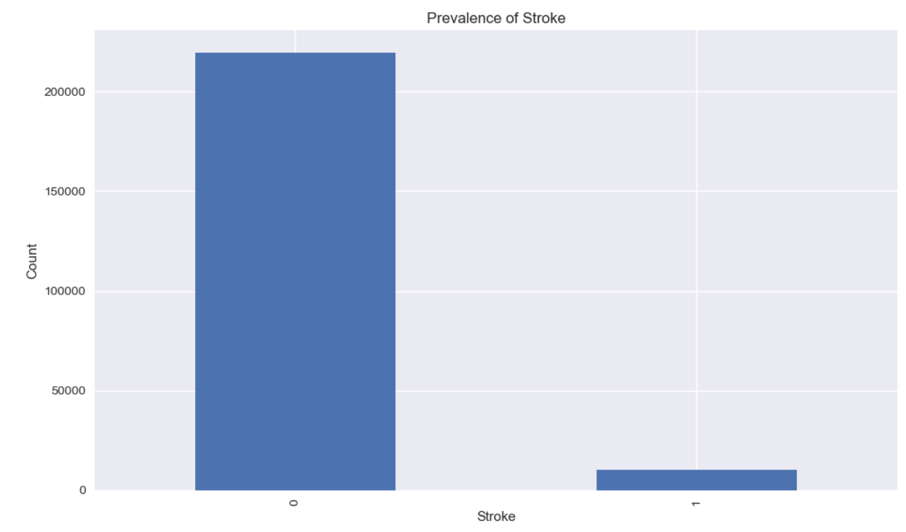
Health Conditions Prevalence
High Blood Pressure: 45.44%
High Cholesterol: 44.18%
Diabetes: 2.38%
Stroke: 4.48%

Slide 11
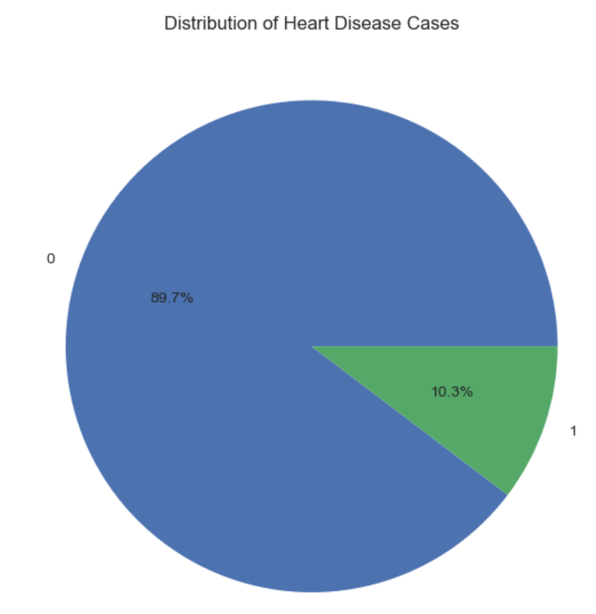
Heart Disease Distribution (Target Variable)
10.32% have experienced heart disease/attack
Significant class imbalance

Slide 12

BIVARIATE ANALYSIS

Slide 13
Bivariate analysis examines the relationship between two variables to understand how one variable may influence or correlate with another. It involves:
→Correlation: Measuring the strength and direction of the relationship between two variables, often using Pearson or Spearman correlation coefficients.
→Scatter Plots: Visualizing the relationship between two continuous variables.
→Cross-tabulation: Summarizing the relationship between two categorical variables, often visualized with contingency tables or heatmaps.
→Comparative Analysis: Comparing the central tendencies and distributions of one variable across different levels of another variable, using box plots, violin plots, or grouped bar charts.

Slide 14
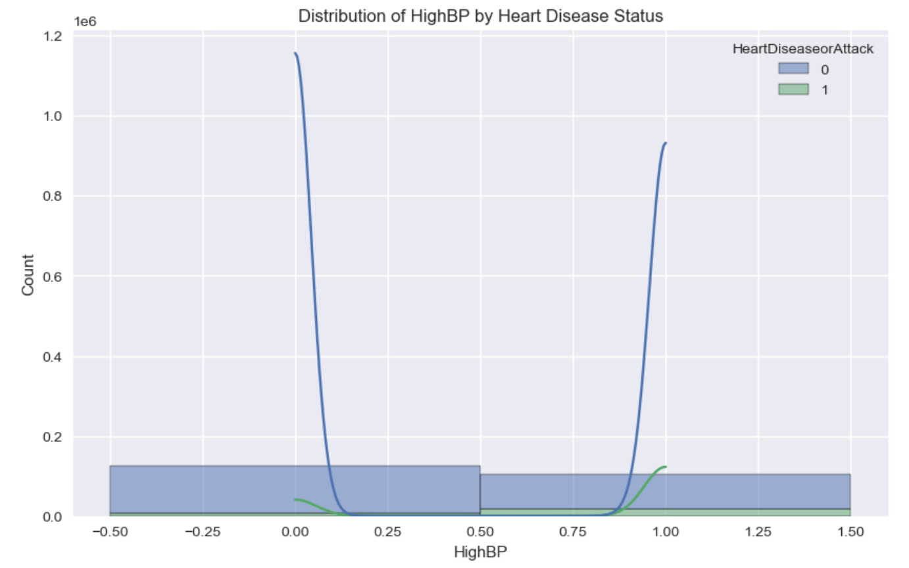
Heart Disease and Blood Pressure
75% with heart disease have high blood pressure
42% without heart disease have high blood pressure
Strong association between high BP and heart disease

Slide 15
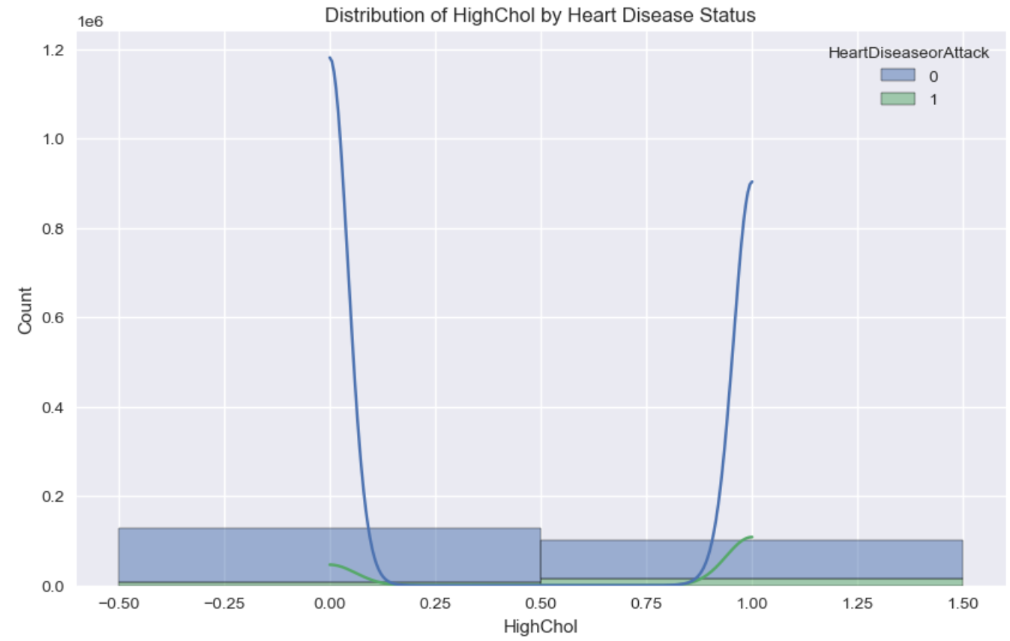
Heart Disease and Cholesterol
70% with heart disease have high cholesterol
41% without heart disease have high cholesterol
Clear association between high cholesterol and heart disease

Slide 16
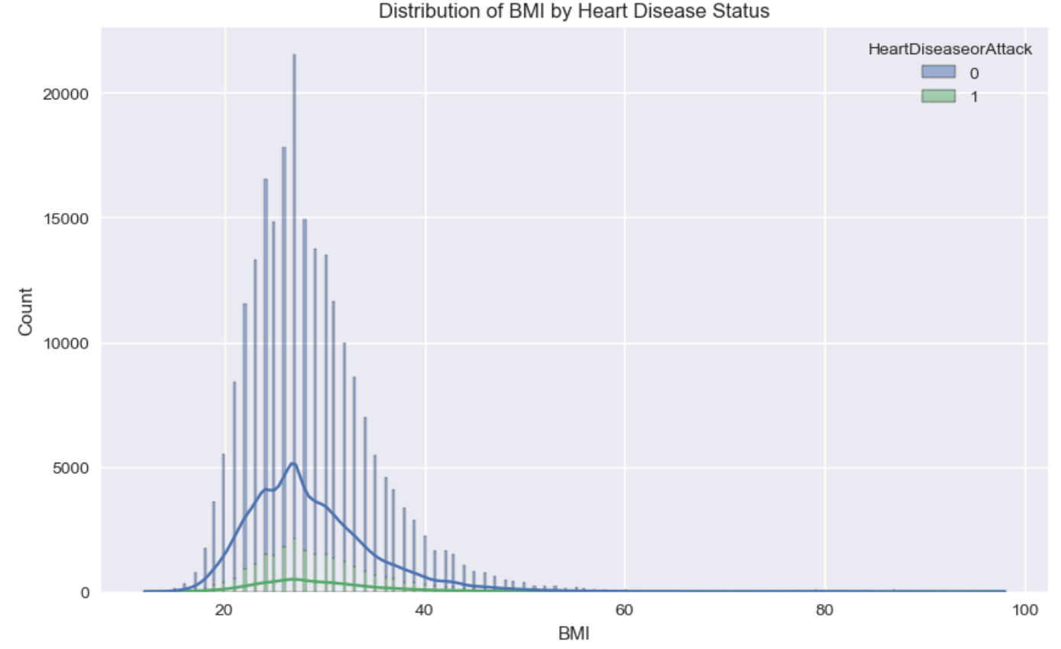
Heart Disease and BMI
Mean BMI (with heart disease): 29.48
Mean BMI (without heart disease): 28.59
Slight increase in BMI for those with heart disease

Slide 17
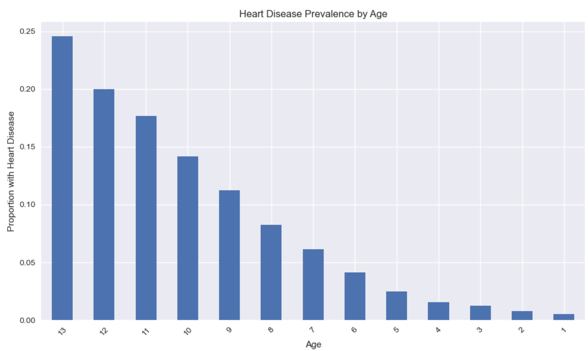
Heart Disease by Age
Prevalence increases with age
Ranges from 0.5% in youngest to 24.55% in oldest group

Slide 18
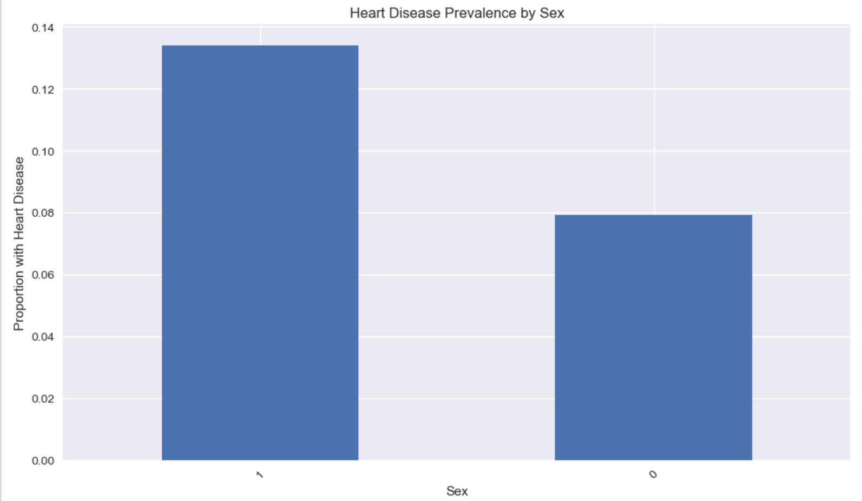
Heart Disease by Sex
Sex 1 (likely male): 13.41% prevalence
Sex 0 (likely female): 7.91% prevalence
Higher risk for one sex (likely males)

Slide 19
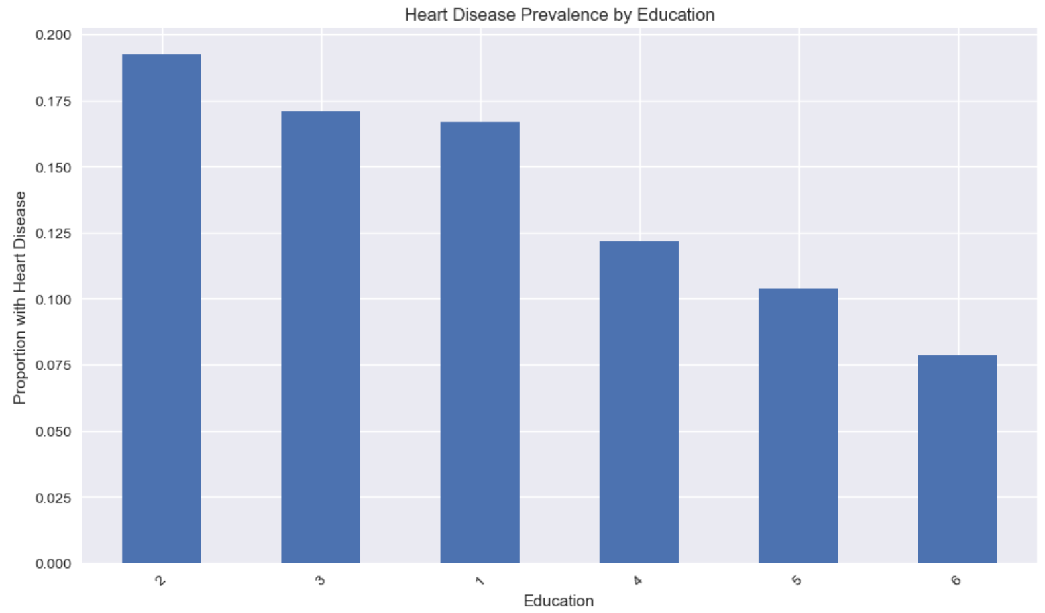
Heart Disease by Education
Highest in Education group 2 (19.26%)
Lowest in Education group 6 (7.86%)
Complex relationship, possibly influenced by other factors

Slide 20
Key Insights
High blood pressure and cholesterol are strongest risk factors
Age shows clear positive correlation with heart disease risk
Sex differences in heart disease prevalence
BMI shows weaker but notable association
Mental and physical health days highly skewed

Slide 21
Potential Risk
Factors
High blood pressure
High cholesterol
Advanced age
Male sex
Higher BMI

Slide 22
Conclusion
Multiple factors associated with heart disease risk
Importance of managing blood pressure and cholesterol
Age and sex as non-modifiable risk factors
Potential for targeted interventions based on risk profiles

